Slide 1

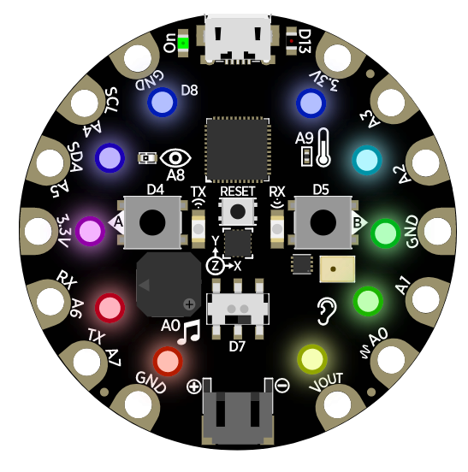


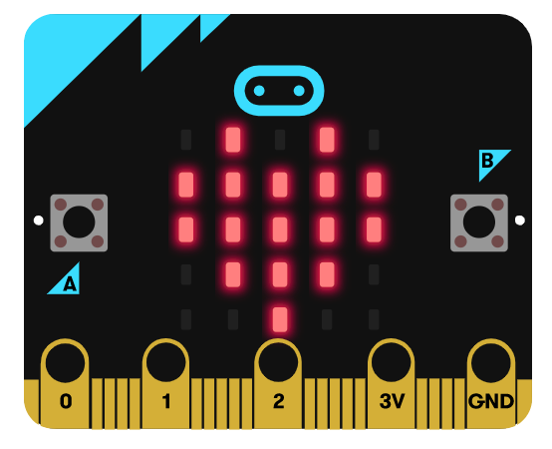
TIME | STREAM
9 AM PST 12 PM EST | MakeCode for the micro:bit
10 AM PST 1 PM EST | MakeCode with Minecraft: Education Edition
11 AM PST 2 PM EST | MakeCode Arcade (Beginner)
1 PM PST 4 PM EST | MakeCode Arcade (Advanced)
2 PM PST 5PM EST | MakeCode in the Kitchen (Friday only)

Slide 2

TIME | STREAM
9 AM PT 12 PM ET | MakeCode for the micro:bit
10 AM PT 1 PM ET | MakeCode with Minecraft: Education Edition
11 AM PT 2 PM ET | MakeCode Arcade (Beginner)
12 PM PT 1 PM MT 3 PM ET | Digital All-Stars (Thursday only) Brandon McManus, Denver Broncos
1 PM PT 4 PM ET | MakeCode Arcade (Advanced)
2 PM PT 5PM ET | MakeCode in the Kitchen (Friday only)

Slide 3
TIME | STREAM
11 AM PT 1 PM CT 2 PM ET | Digital All-Stars (Thursday only) Kevin Byard, Tennessee Titans
1 PM PT 4 PM ET | MakeCode Arcade (Advanced)
2 PM PT 5PM ET | MakeCode in the Kitchen (Friday only)

Slide 4
TIME | STREAM
9 AM PT 12 PM ET | MakeCode for the micro:bit
10 AM PT 1 PM ET | MakeCode with Minecraft: Education Edition
11 AM PT 2 PM ET | MakeCode Arcade (Beginner)
12 PM PT 3 PM ET | MakeCode Live with John Park (Tuesday only)
12 PM PT 1 PM MT 3 PM ET | Digital All-Stars (Thursday only) Brandan Wright, NBA Player
1 PM PT 4 PM ET | MakeCode Arcade (Advanced)
2 PM PT 5PM ET | MakeCode in the Kitchen (Friday only)

Slide 5
TIME | STREAM
9 AM PT 12 PM ET | MakeCode for the micro:bit
10 AM PT 1 PM ET | MakeCode with Minecraft: Education Edition
11 AM PT 2 PM ET | MakeCode Arcade (Beginner)
12 PM PT 3 PM ET | MakeCode Live with John Park (Tuesday only)
12 PM PT 1 PM MT 3 PM ET | Digital All-Stars (Thursday only) Brandan Wright, NBA Player
2 PM PT 5PM ET | MakeCode in the Kitchen (Friday only)

Slide 6
TIME | STREAM
9 AM PT 12 PM ET | MakeCode for the micro:bit
10 AM PT 1 PM ET | MakeCode with Minecraft: Education Edition
11 AM PT 2 PM ET | MakeCode Arcade (Beginner)
12 PM PT 3 PM ET | Digital All-Stars (Monday only) Landon Collins, Washington Redskins
12 PM PT 3 PM ET | MakeCode Live with John Park (Tuesday only)
12 PM PT 3 PM ET | WeCodeMakeCode (Wednesday only)
2 PM PT 5PM ET | MakeCode in the Kitchen (Friday only)

Slide 7



Daily Streams (Monday – Friday)
TIME | STREAM
9 AM PT 12 PM ET | MakeCode for the micro:bit
10 AM PT 1 PM ET | MakeCode with Minecraft
11 AM PT 2 PM ET | MakeCode Arcade (Beginner)
Weekly Streams
DAY | TIME | STREAM
MONDAY | 12 PM PT 3 PM ET | Digital All-Stars Landon Collins
TUESDAY | 12 PM PT 3 PM ET | MakeCode Live with John Park
WEDNESDAY | 12 PM PT 3 PM ET | WeCodeMakeCode
THURSDAY | 1 PM PT 4 PM ET | Micro:bit 2020 Beta Release!
FRIDAY | 2 PM PT 5PM ET | MakeCode in the Kitchen

Slide 8
Daily Streams (Monday – Friday)
TIME | STREAM
9 AM PT 12 PM ET | Micro:bit Beta DEEP DIVE
10 AM PT 1 PM ET | MakeCode with Minecraft
11 AM PT 2 PM ET | MakeCode Arcade (Beginner)
1 PM PT 4 PM ET | MakeCode Arcade (Advanced)
Weekly Streams
DAY | TIME | STREAM
TUESDAY | 12 PM PT 3 PM ET | MakeCode Live with John Park
WEDNESDAY | 12 PM PT 3 PM ET | WeCodeMakeCode
THURSDAY | 12 PM PT 3 PM ET | Digital All-Stars Rashaan Melvin
FRIDAY | 2 PM PT 5PM ET | MakeCode in the Kitchen

Slide 9
Daily Streams (Monday – Friday)
TIME | STREAM
9 AM PT 12 PM ET | MakeCode for the Micro:bit
10 AM PT 1 PM ET | MakeCode with Minecraft
11 AM PT 2 PM ET | MakeCode Arcade (Beginner)
1 PM PT 4 PM ET | MakeCode Arcade (Advanced)
Weekly Streams
DAY | TIME | STREAM
TUESDAY | 12 PM PT 3 PM ET | MakeCode Live with John Park
WEDNESDAY | 12 PM PT 3 PM ET | WeCodeMakeCode
FRIDAY | 2 PM PT 5PM ET | MakeCode in the Kitchen

Slide 10
Daily Streams (Monday – Friday)
TIME | STREAM
9 AM PT 12 PM ET | MakeCode for the Micro:bit
10 AM PT 1 PM ET | MakeCode with Minecraft
11 AM PT 2 PM ET | MakeCode Arcade (Beginner)
1 PM PT 4 PM ET | MakeCode Arcade (Advanced)
Weekly Streams
DAY | TIME | STREAM
TUESDAY | 12 PM PT 3 PM ET | MakeCode Live with John Park
WEDNESDAY | 12 PM PT 3 PM ET | WeCodeMakeCode
THURSDAY | 1:30 PM PT 4:30 PM ET | Digital All-Stars Hayley Orrantia

Slide 11


Daily Streams (Monday – Friday)
TIME | STREAM
1 PM PT 4 PM ET | MakeCode Arcade (Advanced)
Weekly Streams
DAY | TIME | STREAM
TUESDAY | 12 PM PT 3 PM ET | MakeCode Live with John Park
WEDNESDAY | 12 PM PT 3 PM ET | WeCodeMakeCode
THURSDAY | 9 AM PT 12 AM ET | MakeCode and GitHub
THURSDAY | 12 PM PT 3 PM ET | Digital All-Stars Brandan Wright
FRIDAY | 2 PM PT 5PM ET | MakeCode in the Kitchen
Notes:
May 25-29

Slide 12
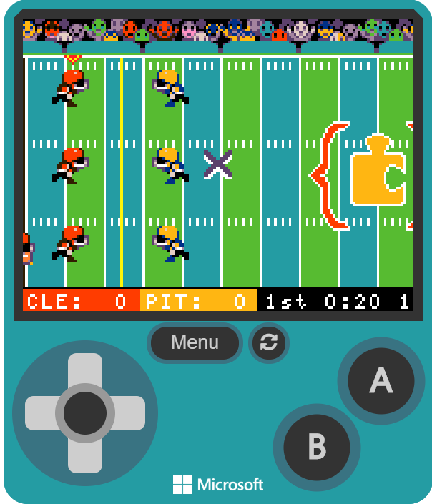
Weekly Streams
DAY | TIME | STREAM
WEDNESDAY | 12 PM PT 3 PM ET | WeCodeMakeCode
THURSDAY | 12 PM PT 3 PM ET | Digital All-Stars Davon Godchaux
Daily Streams cancelled this week
Notes:
June 1-5

Slide 13
Daily Streams (Monday – Friday)
TIME | STREAM
9 AM PT 12 PM ET | MakeCode for the Micro:bit
10 AM PT 1 PM ET | MakeCode with Minecraft
11 AM PT 2 PM ET | MakeCode Arcade (Beginner)
1 PM PT 4 PM ET | MakeCode Arcade (Advanced)
Weekly Streams
DAY | TIME | STREAM
TUESDAY | 12 PM PT 3 PM ET | MakeCode Live with John Park
WEDNESDAY | 12 PM PT 3 PM ET | WeCodeMakeCode
THURSDAY | 12 PM PT 3 PM ET | Digital All-Stars Deon Bush
THURSDAY | 1 PM PT 4 PM ET | MakeCode Arcade Game Jam with Sten Huebler
FRIDAY | 9 AM PT 12 PM ET | MakeCode Micro:bit 2020!
FRIDAY | 2 PM PT 5PM ET | MakeCode in the Kitchen
Notes:
June 8-12

Slide 14
STREAMS for the week of June 8th – 12th
MONDAY |  | TUESDAY |  | WEDNESDAY |  | THURSDAY |  | FRIDAY
9 AM PT 12 PM ET | MakeCode for the Micro:bit | 9 AM PT 12 PM ET | MakeCode for the Micro:bit | 9 AM PT 12 PM ET | MakeCode for the Micro:bit | 9 AM PT 12 PM ET | MakeCode for the Micro:bit | 9 AM PT 12 PM ET | MakeCode Micro:bit 2020!
10 AM PT 1 PM ET | MakeCode with Minecraft | 10 AM PT 1 PM ET | MakeCode with Minecraft | 10 AM PT 1 PM ET | MakeCode with Minecraft | 10 AM PT 1 PM ET | MakeCode with Minecraft | 1 PM PT 4 PM ET | MakeCode Arcade (Advanced)
11 AM PT 2 PM ET | MakeCode Arcade (Beginner) | 11 AM PT 2 PM ET | MakeCode Arcade (Beginner) | 11 AM PT 2 PM ET | MakeCode Arcade (Beginner) | 11 AM PT 2 PM ET | MakeCode Arcade (Beginner) | 2 PM PT 5 PM ET | MakeCode in the Kitchen
1 PM PT 4 PM ET | MakeCode Arcade (Advanced) | 12 PM PT 3 PM ET | MakeCode Live with John Park | 12 PM PT 3 PM ET | WeCodeMakeCode | 12 PM PT 3 PM ET | Digital All-Stars Deon Bush
 |  | 1 PM PT 4 PM ET | MakeCode Arcade (Advanced) | 1 PM PT 4 PM ET | MakeCode Arcade (Advanced) | 1 PM PT 4 PM ET | Arcade Game Jam with Sten Huebler
Notes:
June 8-12

Slide 15
STREAMS for the week of June 15th – 19th
MONDAY |  | TUESDAY |  | WEDNESDAY |  | THURSDAY |  | FRIDAY
9 AM PT 12 PM ET | MakeCode for the Micro:bit | 9 AM PT 12 PM ET | MakeCode for the Micro:bit | 9 AM PT 12 PM ET | MakeCode for the Micro:bit | 9 AM PT 12 PM ET | MakeCode for the Micro:bit | 1 PM PT 4 PM ET | MakeCode Arcade (Advanced)
10 AM PT 1 PM ET | MakeCode with Minecraft | 10 AM PT 1 PM ET | MakeCode with Minecraft | 10 AM PT 1 PM ET | MakeCode with Minecraft | 10 AM PT 1 PM ET | MakeCode with Minecraft | 2 PM PT 5 PM ET | MakeCode in the Kitchen
11 AM PT 2 PM ET | MakeCode Arcade (Beginner) | 11 AM PT 2 PM ET | MakeCode Arcade (Beginner) | 11 AM PT 2 PM ET | MakeCode Arcade (Beginner) | 11 AM PT 2 PM ET | MakeCode Arcade (Beginner)
1 PM PT 4 PM ET | MakeCode Arcade (Advanced) | 12 PM PT 3 PM ET | MakeCode Live with John Park | 12 PM PT 3 PM ET | WeCodeMakeCode | 1 PM PT 4 PM ET | MakeCode Arcade (Advanced)
 |  | 1 PM PT 4 PM ET | Arcade Game Jam with Stu Maxwell | 1 PM PT 4 PM ET | MakeCode Arcade (Advanced) | 2 PM PT 5 PM ET | Digital All-Stars Matt Bersano
Notes:
June 15-19

Slide 16
STREAMS for the week of June 15th – 19th
MONDAY |  | TUESDAY |  | WEDNESDAY |  | THURSDAY |  | FRIDAY
9 AM PT 12 PM ET | MakeCode for the Micro:bit | 9 AM PT 12 PM ET | MakeCode for the Micro:bit |  |  | 9 AM PT 12 PM ET | MakeCode for the Micro:bit | 1 PM PT 4 PM ET | MakeCode Arcade (Advanced)
10 AM PT 1 PM ET | MakeCode with Minecraft | 10 AM PT 1 PM ET | MakeCode with Minecraft |  |  | 10 AM PT 1 PM ET | MakeCode with Minecraft | 2 PM PT 5 PM ET | MakeCode in the Kitchen
11 AM PT 2 PM ET | MakeCode Arcade (Beginner) | 11 AM PT 2 PM ET | MakeCode Arcade (Beginner) |  |  | 11 AM PT 2 PM ET | MakeCode Arcade (Beginner)
1 PM PT 4 PM ET | MakeCode Arcade (Advanced) | 12 PM PT 3 PM ET | MakeCode Live with John Park | 12 PM PT 3 PM ET | WeCodeMakeCode | 1 PM PT 4 PM ET | MakeCode Arcade (Advanced)
 |  | 1 PM PT 4 PM ET | Arcade Game Jam with Stu Maxwell | 1 PM PT 4 PM ET | MakeCode Arcade (Advanced) | 2 PM PT 5 PM ET | Digital All-Stars Matt Bersano
Notes:
June 15-19

Slide 17
Weekly Streams
DAY | TIME | STREAM
TUESDAY | 12 PM PT 3 PM ET | MakeCode Live with John Park
TUESDAY | 1 PM PT 4 PM ET | MakeCode Arcade Game Jam with Stu Maxwell
WEDNESDAY | 12 PM PT 3 PM ET | WeCodeMakeCode
THURSDAY | 12 PM PT 3 PM ET | Digital All-Stars
FRIDAY | 2 PM PT 5PM ET | MakeCode in the Kitchen
Daily Streams (Monday – Friday)
TIME | STREAM
9 AM PT 12 PM ET | MakeCode for the Micro:bit
10 AM PT 1 PM ET | MakeCode with Minecraft
11 AM PT 2 PM ET | MakeCode Arcade (Beginner)
1 PM PT 4 PM ET | MakeCode Arcade (Advanced)
Notes:
June 15-19

Slide 18
Daily Streams (Monday – Friday)
TIME | STREAM
9 AM PT 12 PM ET | MakeCode for the Micro:bit
10 AM PT 1 PM ET | MakeCode with Minecraft
11 AM PT 2 PM ET | MakeCode Arcade (Beginner)
1 PM PT 4 PM ET | MakeCode Arcade (Advanced)
Weekly Streams
DAY | TIME | STREAM
TUESDAY | 12 PM PT 3 PM ET | MakeCode Live with John Park
WEDNESDAY | 12 PM PT 3 PM ET | WeCodeMakeCode
THURSDAY | 12 PM PT 3 PM ET | Digital All-Stars
FRIDAY | 2 PM PT 5PM ET | MakeCode in the Kitchen
Notes:
June 22-25

Slide 19
Daily Streams (Monday – Friday)
TIME | STREAM
9 AM PT 12 PM ET | MakeCode for the Micro:bit
10 AM PT 1 PM ET | MakeCode with Minecraft
11 AM PT 2 PM ET | MakeCode Arcade (Beginner)
1 PM PT 4 PM ET | MakeCode Arcade (Advanced)
Weekly Streams
DAY | TIME | STREAM
TUESDAY | 12 PM PT 3 PM ET | MakeCode Live with John Park
WEDNESDAY | 12 PM PT 3 PM ET | WeCodeMakeCode
THURSDAY | 12 PM PT 3 PM ET | Digital All-Stars
FRIDAY | 2 PM PT 5PM ET | MakeCode in the Kitchen
Notes:
June 29-July 3

Slide 20
Daily Streams (Monday – Friday)
TIME | STREAM
9 AM PT 12 PM ET | MakeCode for the Micro:bit
10 AM PT 1 PM ET | MakeCode with Minecraft
11 AM PT 2 PM ET | MakeCode Arcade (Beginner)
1 PM PT 4 PM ET | MakeCode Arcade (Advanced)
Weekly Streams
DAY | TIME | STREAM
TUESDAY | 12 PM PT 3 PM ET | MakeCode Live with John Park
WEDNESDAY | 12 PM PT 3 PM ET | WeCodeMakeCode
THURSDAY | 12 PM PT 3 PM ET | Digital All-Stars
FRIDAY | 2 PM PT 5PM ET | MakeCode in the Kitchen
Notes:
July 6-10

Slide 21
Daily Streams (Monday – Friday)
TIME | STREAM
9 AM PT 12 PM ET | MakeCode for the Micro:bit
10 AM PT 1 PM ET | MakeCode with Minecraft
11 AM PT 2 PM ET | MakeCode Arcade (Beginner)
1 PM PT 4 PM ET | MakeCode Arcade (Advanced)
Weekly Streams
DAY | TIME | STREAM
TUESDAY | 12 PM PT 3 PM ET | MakeCode Live with John Park
WEDNESDAY | 12 PM PT 3 PM ET | WeCodeMakeCode
THURSDAY | 12 PM PT 3 PM ET | Digital All-Stars
FRIDAY | 2 PM PT 5PM ET | MakeCode in the Kitchen
Notes:
July 13-17

Slide 22
Daily Streams (Monday – Friday)
TIME | STREAM
9 AM PT 12 PM ET | MakeCode for the Micro:bit
10 AM PT 1 PM ET | MakeCode with Minecraft
11 AM PT 2 PM ET | MakeCode Arcade (Beginner)
1 PM PT 4 PM ET | MakeCode Arcade (Advanced)
Weekly Streams
DAY | TIME | STREAM
TUESDAY | 12 PM PT 3 PM ET | MakeCode Live with John Park
WEDNESDAY | 12 PM PT 3 PM ET | WeCodeMakeCode
THURSDAY | 12 PM PT 3 PM ET | Digital All-Stars
FRIDAY | 2 PM PT 5PM ET | MakeCode in the Kitchen
Notes:
July 20-24

Slide 23
Daily Streams (Monday – Friday)
TIME | STREAM
9 AM PT 12 PM ET | MakeCode for the Micro:bit
10 AM PT 1 PM ET | MakeCode with Minecraft
11 AM PT 2 PM ET | MakeCode Arcade (Beginner)
1 PM PT 4 PM ET | MakeCode Arcade (Advanced)
Weekly Streams
DAY | TIME | STREAM
TUESDAY | 12 PM PT 3 PM ET | MakeCode Live with John Park
WEDNESDAY | 12 PM PT 3 PM ET | WeCodeMakeCode
THURSDAY | 12 PM PT 3 PM ET | Digital All-Stars
FRIDAY | 2 PM PT 5PM ET | MakeCode in the Kitchen
Notes:
July 27-31

